Slide 1
Agenda
Time | Contents
15 min. | Presentation | 1. Project overview 2. Architectural driver 3. Perspective view 4. Architectural Design 5. Design & Implementation 6. Wrap up
15 min. | Demo | 1. Add home node 2. Add mailbox node 3. Away mode 4. Secure mode 5. Malfunction mode 6. Add rule 7. Show Log & Remove node
10 min. | Q & A
Notes:
DBR2 : 센서 / 엑츄에이터 예제 서술
DBR3 : 센서 구조 예제 그림 그리기

Slide 2
IoT Management System (Initial Presentation)
Team 2

Slide 3
CONTENTS

Slide 4
1. Project Overview
Overview
Our Team is working for an organization that intends to enter the IoT market.
We make an Internet of Things(IoT) system that enables end-users to communicate with sensors and actuators installed in the home or business via PC or smartphone connected to the internet.
(For example, indoor and outdoor light, temp and humidity sensor, door open-close actuator, door open-close sensor, secure alarm, presence/proximity sensor)
Notes:
DBR2 : 센서 / 엑츄에이터 예제 서술
DBR3 : 센서 구조 예제 그림 그리기

Slide 5
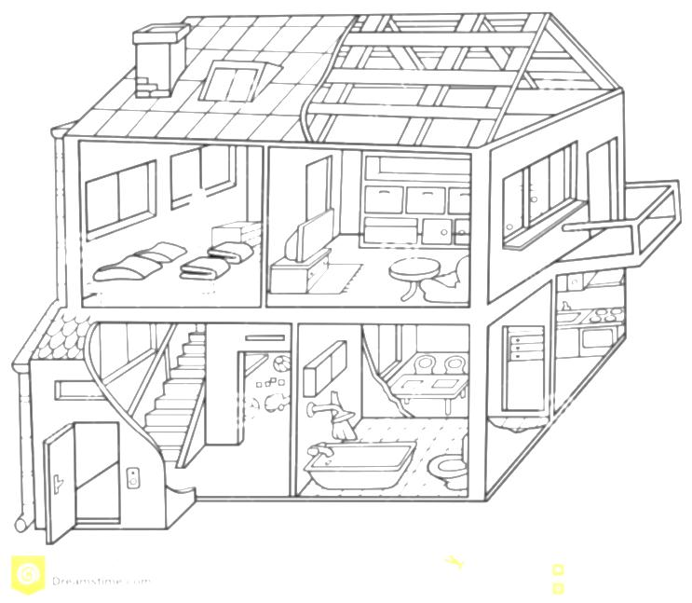




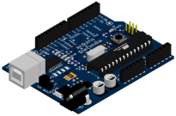



1. Project Overview
Environment of project
The home or business uses the internet with standard Wi-Fi router.
Sensors / actuators can connect to the home or business network with Arduino microcontroller enabled Wi-Fi.
Temp.
sensor
Presence
Sensor
Light
Secure Alarm
Humidity
sensor
Arduino
Door
Open-Close
Wi-Fi
router

Slide 6
2. Architectural Drivers
2.1. Function Requirements
2.2. Quality Attributes
2.3. Quality Attributes Utility

Slide 7
2.1 Context - Market, Organizational
Market Context
Stakeholders | Customer, End-user, System Installer, Developer
System Access | Users want to access the system via PC, Mobile devices
Functional expectations | After system installation, users expect the system to work automatically by assigned rules of sensors and actuators
Environment | There are many vendors developing a system, sensors and actuators. But there is no standard of interface.
Organizational Context
Roles and responsibilities | Project Manager(includes planning, risk and configuration, schedule) Architect Requirement Manager Test Manager Documentation Manager Developer (all members)
Technical background | Digital-Appliance SW solution researcher & developer Smart-phone SW developer Camera module testing SW developer
Notes:
DBR4 :Any more assumptions? Such as using commonly found sensors, actuators to reduce cost? Using open source apps. Would the browser be different for mobile devices and PC's :
DBR5 : How about planning manager, risk manager, configuration manager, customer liaison? If you sourced these roles from a framework then which one?
DBR6 : Very broad. Can you be more specific, consumer durable goods, or IT or government products?

Slide 8
2.1 Context - Business, Technical
Business Context
Date of Delivery | 26 June 2015
Time Resources | 498 man-hours (48+450) :48 man-hours (8 hours X 6 people) in Korea :450 man-hours(3 hours X 6 people X 5 days X 5 weeks) in CMU
Strategy | Easy to use & high extensibility for sensors/actuators
Target Market | B2B - Building Architect Office, B2C - DIY User
Profit Model | Rental Service, Standalone, System Education, Maintenance
Future direction | Many kinds of sensors/actuators(indoor air quality sensor, camera, thermostat controller and so forth) is used & it makes a lot of use case. So big-data of these cases would enable to make services of IoT System.
Technical Context
Development Skills | Java , C, JavaScript, HTML5
Platforms | Arduino Platform, Laptop Computers
Tools | Eclipse, Arduino IDE
OS | Windows, Linux
HW platform | Arduino , X86
Notes:
DBR7 : May be better to consider hours here instead of 7 weeks. Would that be a better measure of to use for determining what you can get done?
→ working day 3hours, Weekend 8hours
DBR8 : Such as? Examples
→ 센서 : 조도 센서, 거리센서, 컬러 스펙트럼 센서 , 카메라
→ actuator : 온도 조절기 , 조도 조절기 , ????
DBR9 : this is good to consider technical risks early.

Slide 9
2.2 Stakeholders
Stakeholders of the IoT Management System (IoTMS)
Customer
End-User
System Installer
Application Developer
Value-added-resellers (VARs)
Service Provider
Maintainer
Project consultant (or mentor)
Notes:
DBR10 : How about project consultant, or mentor too?
DBR 11 : Good, but usually in the US we spell out the acronym first and then in parens give the acronym. As is this is OK

Slide 10
2.1 Functional Requirement
Req. ID | Description
FR-09 | The system should automatically turn off the lights when no one is home and 10 minutes elapses (configurable, 5 minutes is the default value - feel free to shorten this to a few seconds for test and demonstration purposes).
FR-10 | It should be easy for users to add and remove nodes to and from the system without having to restart the system or other nodes (you will have to demonstrate this). This includes secure registration and recognition of the type of sensors and actuators provided by the node.
FR-11 | The system should make it easy for application developers (private persons, VARs, or other 3rd parties) to build custom apps, services, and/or make mashups from existing available services (you should describe how the design supports this).
FR-12 | The system should make it easy for developers to implement new protocol about new devices.
FR-13 | The system provides user define scenario service like IFTTT(IF This Then That)
FR-14 | When the system sends emergency message, it will be E-mail. In future, it can be SMS or tweet.
FR-15 | When sensors value is abnormal(out of range), the system sends an alarm message to user.
FR-16 | User sets configurations of E-mail address, logging-duration, secure response time and lights waiting time.
FR-17 | The system provides Web APIs for Web developer.
Notes:
DBR15 : added by whom

Slide 11
2.3 Quality Attributes Utility
QA Type | ID | Description | Priority | Difficulty
Availability | QA-01 | Server recognizes malfunction of sensors within 10 seconds. | High | Medium
 | QA-08 | Detect and notify Logging failure in 30 seconds. | Low | Low
Usability | QA-02 | All function of System is served in 3 depth UI. | Low | Medium
Scalability | QA-03 | IoTMS allow up to 50 SA Nodes. | High | Medium
Modifiability | QA-04 | Emerging new protocol, it is possible to be developed in 2 man-months. | Medium | Medium
Security | QA-05 | IoT Management System allow only authorized user to access in secure way. | High | Medium
Testability | QA-06 | 80% of test cases can be tested within 1 day. | Medium | Medium
Performance | QA-07 | The response time of controlling and monitoring is within 10 seconds. | Medium | High

Slide 12
2.3 Constraints
Business Constraints
ID | Description
CST-01 | Schedule Limitation: 7 weeks(include a plan-time in Korea) 498 man-hours (48+450) :48 man-hours (8 hours X 6 people) in Korea :450 man-hours(3 hours X 6 people X 5 days X 5 weeks) in CMU
CST-02 | Human Resources: 6 people
CST-03 | User can’t buy SA nodes and sensors/actuators separately.
Technical Constraints
ID | Description
CST-01 | End-user communicates with sensors/actuators via PC or Smartphone connected to the Internet.
CST-02 | An SA node has 1 or more sensors/actuators.
CST-03 | An SA node uses Wi-Fi communication(802.11)
CST-04 | The IoTMS should be made by Java Language & Arduino device
CST-05 | The IoTMS works on PC or Server
Notes:
DBR21 : As recommend use hours, may be a better granualrity. Weeks implies a work week of 40 hours minimum. Willl you have that much time? DBR22 : Another area where minimum may be better for planning. And it isn't 7 people? Also, are all developers?

Slide 13
3. Perspective view
3.1. System context view
3.2. Allocation view
3.3. Dynamic view

Slide 14
3.1 System context view
Node
IoTMS
<< Display information >>
User Authorization Success / Fail
Node Authorization Success / Fail
Set Rule Success / Fail
Display Log information
- Node information
- Node information for registration
Sensing Data : Temperature/Humidity/Door /Presence(proximity)/Mail Box
Command :
Door on/off, light on/off,
alarm on/off
- Register node
Log In
Register User
Add, Delete Node
Set Customize rule
Log information
Set Alarm mode (Secure / Unsecure)
Door on/off
- Light on/off
Legend
: System Element
: User
: Data flow
: User action(Event) to IoTMS

Slide 15




3.2 Physical perspective viewView
Home PC
Web Browser
Mobile device , office PC
Web Browser
Internet
http
IoTMS
http
Web Server
(apache-tomcat-8.0.23)
Legend
http
Port #8080(User)
Database
(mariadb-10.0.19)
TCP
Port #550
(Arduino)
IoTMS
Server
Machine
Windows 7
Data
repository
TCP
Port #3250(Discovery)
TCP
Port #3250(Discovery)
TCP
Port #3250(Discovery)
Sensor
first node
second node
50th node
User
Machine
arduino-1.0.6
arduino-1.0.6
……..
arduino-1.0.6
node
Arduino
node
Door
Door
Mail
box
Senor 1
Actuator 1
SW on Machine
Temp.
&Humi.
Alarm
……..
…..
…..
Actuator
Proxi.
Light
Senor N
Actuator N
Router
11/32

Slide 16
3.3 Dynamic perspective viewView
Web UI
User DB
Log DB
event bus
watchdog
e-mail
twitter
Rule DB
Legend
message
confirm
A
B
kick
reset
: JSON event , from A to B
User Interface Manager
Log Manager
Message Manager
Rule Manager
A
B
: information, from A to B
A
B
: TCP/IP , from A to B
E v e n t B u s + J S O N
DB
Manager
Communication
Manager
Node Manager
Thing object
(Sensor, actuator...)
Node object
Node
Node
Node
Link object
Link
Link
SA node (Arduino)
Things object List
user access
JSON
JSON
actuators
sensors
Default
sensors
thread
SA
actuators
sensors
Default
sensors
Home , mail box , …. , 50th node
12/32

Slide 17
4. Architectural Design
4.1. Design Decision – Why Client/Server?
4.2. Design Decision – Why Event Bus?
4.3. Design Decision – Why JSON?

Slide 18
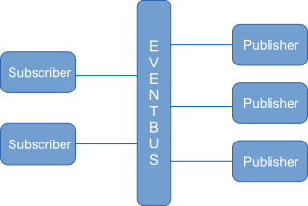
4.2 Design Decision – Why Event Bus?
Advantage
1) Less coupling among packages
Failure of any single package doesn’t affect the whole system
Each packages can be developed independently
2) Easy to track the interaction between packages
Centralized logging environment
3) Provides extensibility
Easy to add new nodes
Easy to add new feature such as message package and something like that
Disadvantage
1) Single point of failure
Event bus should be easily recoverable
2) Traffic
50 simultaneous connection is tolerable based on the experiment.

Slide 19
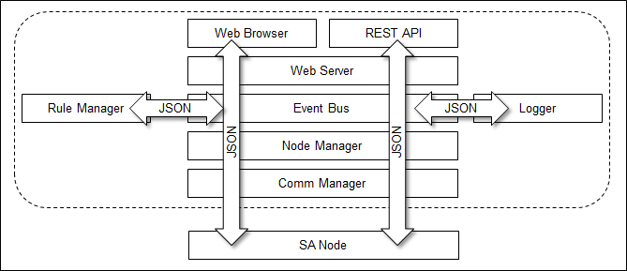
4.3 Design Decision – Why JSON?
Less coupling among packages
Cross platform
Human readable
Applying design concept to implementation directly
UI and SA Node speak the same language
3rd party developers
UI (Java Script) and database friendly

Slide 20
5. Design & Implementation
5.1. Security
5.2. Availability
5.3. Modifiability
5.4. Scalability
5.5. Performance

Slide 21
5.1.1 Security – User Management
[Design decision]
User Access
View
Framework :
- Spring framework can filter user access with URL Pattern.
- It uses access filter xml, so it applies user access control easily
- should be necessary to study framework.
Spring Intercept
URL
Spring validates
[Login failed]
Organic :
- If using cookie, It can develop simply.
- But we can apply just web page. According to implementation, it cannot apply at Web API.
- And it is more chance to mistake.
[Login successful]
Spring displays
View
Spring displays
error message
Spring shows
Login page
User Enter
id & password

Slide 22
5.1.2 Security – Network Transport
System 큰 그림

Slide 23
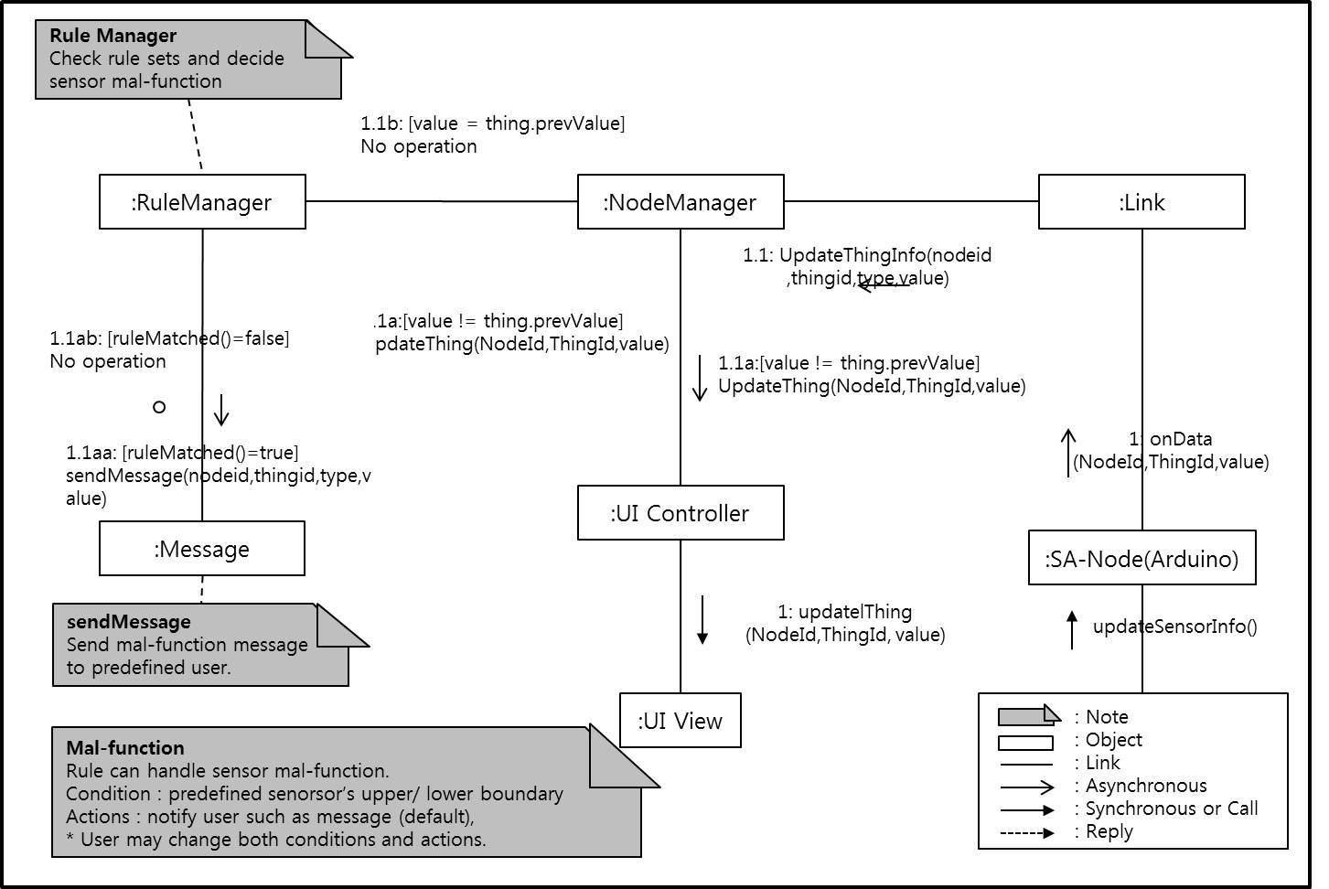
5.2.1 Availability – Sensor Malfunction.

Slide 24
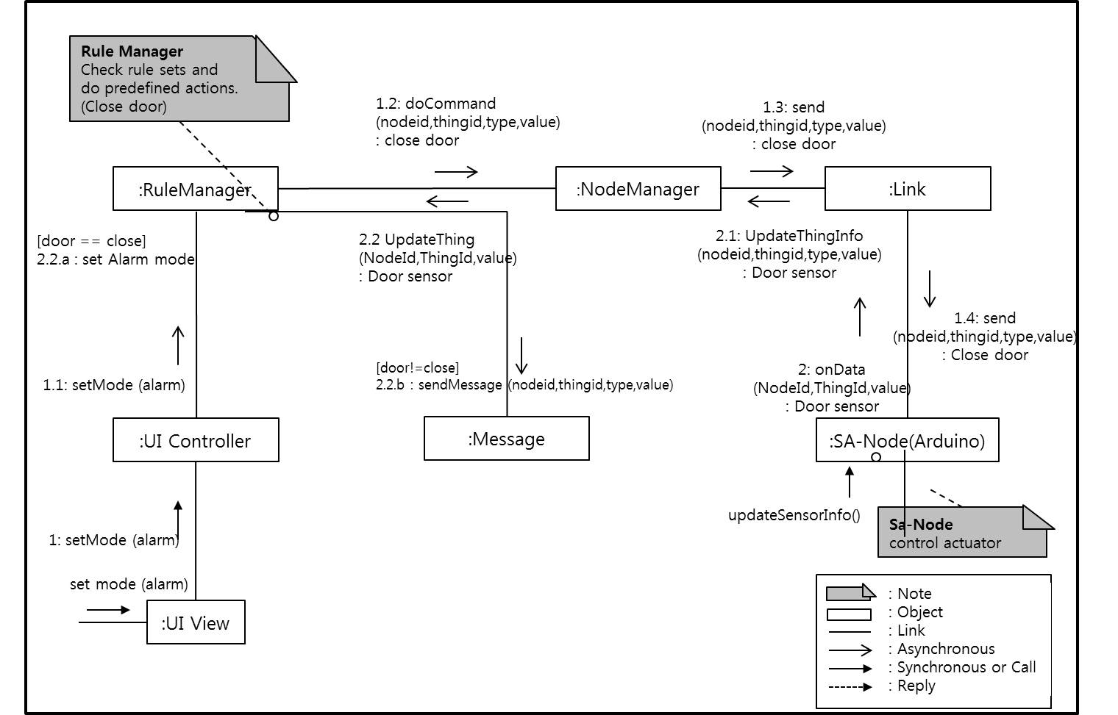
5.2.2 Availability – Actuator Malfunction.
ㅌ

Slide 25
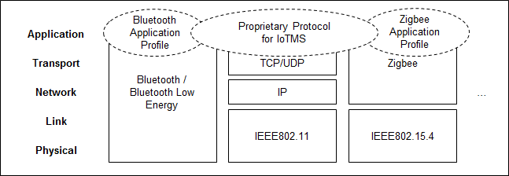
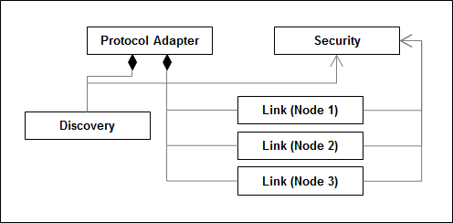
5.3.1 Modifiability
System 큰 그림
Discovery | discover
 | register
 | cancel
Link | connect
 | disconnect
 | send
 | receiver

Slide 26
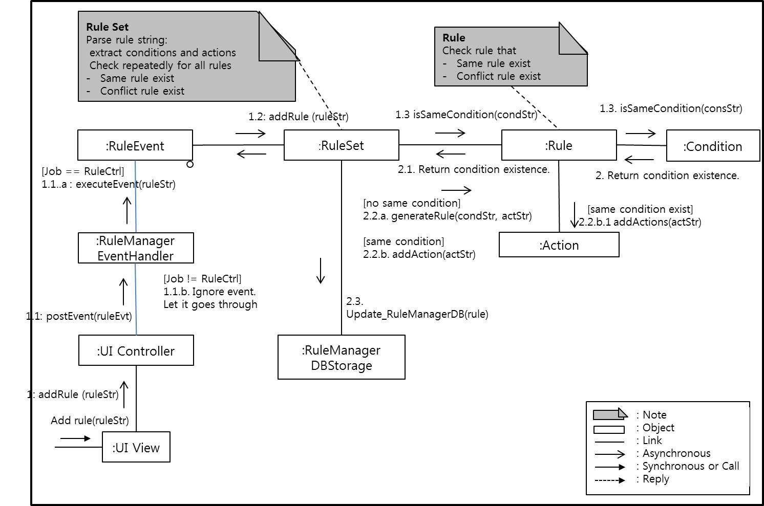
5.3.2 Modifiability - User defined rule
Rule := if {conditions} then {actions} [condition := {nodeID}@{thingID}=={Value}#{Type}(Delay)?]
ex) if nodeA@presenceA==Away#Presence then *@messageA=Confirm#MessageDelay, *@alarm=Setting#AlarmDelay
if *@alarm==Set#Alarm then !nodeA@doorA=Open#Door, nodeA@alarmLampA=On#Alarm
if nodeB@temp==Over35#Temperature, nodeA@preseceA==AtHome#Presence then nodeB@aircon=On@AirConditioner

Slide 27
5.4.1 Scalability and Performance
Experiment for Scalability and Performance
Environement
IoTMS : Intel I5 2.7Ghz, 4GB RAM
2nd PC for virtual Node : Atom 1.33Ghz, 2GB RAM
SA Node : Arduino
Experiment Steps
Experiment Steps
Run IoTMS Connect a Real SA Node to IoTMS IoTMS send Ping to Real SA Node every 1sec The second PC creates Virtual Nodes made for simulation The second PC makes Node increase 1 per every sec Node sned Thing information to IoTMS every 3sec The second PC makes Node increase until 500ea We measure response of echo from Real SA Node

Slide 28
5.4.1 Scalability and Performance
Which quality attributes can be satisfied?
QA Type | ID | Description | Priority | Difficulty
Availability | QA-01 | Server recognizes malfunction of sensors within 10 seconds. | High | Medium
 | QA-08 | Detect and notify Logging failure in 30 seconds. | Low | Low
Usability | QA-02 | All function of System is served in 3 depth UI. | Low | Medium
Scalability | QA-03 | IoTMS allow up to 50 SA Nodes. | High | Medium
Modifiability | QA-04 | Emerging new protocol, it is possible to be developed in 2 man-months. | Medium | Medium
Security | QA-05 | IoT Management System allow only authorized user to access in secure way. | High | Medium
Testability | QA-06 | 80% of test cases can be tested within 1 day. | Medium | Medium
Performance | QA-07 | The response time of controlling and monitoring is within 10 seconds. | Medium | High

Slide 29
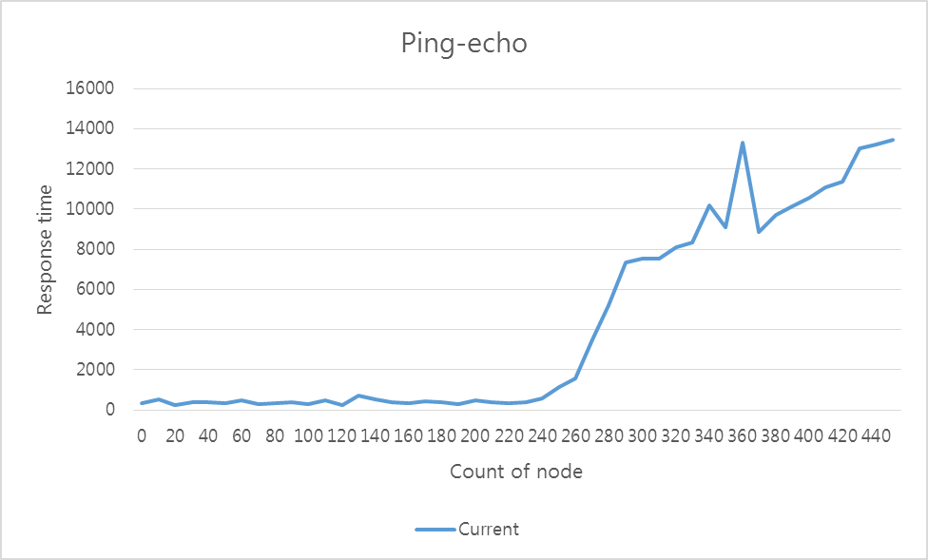
5.4.1 Scalability and Performance
Result of Ping-echo
250

Slide 30
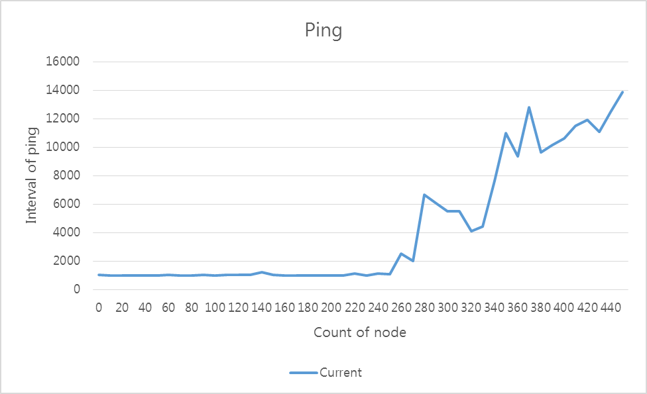
5.4.1 Scalability and Performance
Result of Ping Interval
IoTMS overload

Slide 31
5.4.1 Scalability and Performance
How we solve IoTMS overload?
Using degradation
If Nodes are 250 or more,
Event period change from 3 seconds to 6 seconds
IoTMS
IoTMS
Send information
every 3 sec
Send information
every 6 sec
Node
Node
Node
Node

Slide 32
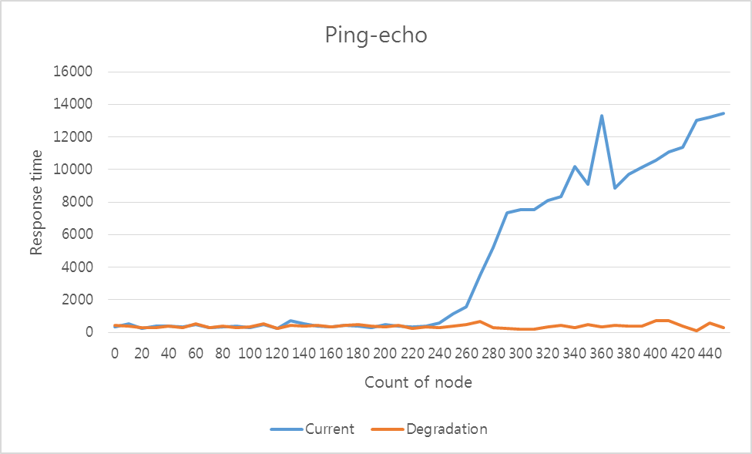
5.4.1 Scalability and Performance
Result of experiment with degradation
Node 250

Slide 33
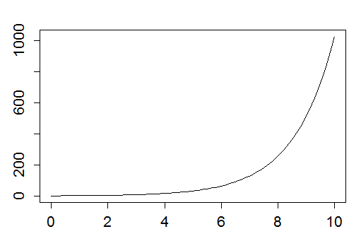

5.4.3 Scalability – Test w/ 50 SA Nodes
Web Browser
Simulator
Simulating 50 SA Nodes
X
http
TCP
Port #3250~3300
(Discovery)
IoTMS
Web Server
(apache-tomcat-8.0.23)
http
Port #8080(User)
Database
(mariadb-10.0.19)
TCP
Port #550
(Arduino)
Fig) Chart for Test result
Windows 7
TCP
Port #3250(Discovery)
Legend
first node
Test result should be here
Server
Machine
IoTMS
node
arduino-1.0.6
Arduino
node
Door
Door
Data
repository
SW on Machine
Temp.
&Humi.
Alarm
Sensor
Actuator
User
Machine
Router
Proxi.
Light

Slide 34
5.5 Performance
Periodic SA Node’s Health Check
There’re numbers of different tactics for providing availability. For example,
- ping-echo
- heartbeat
- piggyback
Periodic data transfer every 3 seconds which Ping-echo and heartbeat do will consume some computation and network resources. If the number of nodes increased, ping-echo and heartbeat tactics might be a burden.
The reason why we chose piggybacking is that there already exists periodic events which updating sensor data every 3 second. Therefore, there’s no need to transmit additional data exchange such as heartbeat or ping-echo.

Slide 35
6. Wrap up
6.1. Time Log and Earn Value
6.2. Role and Responsibility
6.3. Lessons Learned

Slide 36
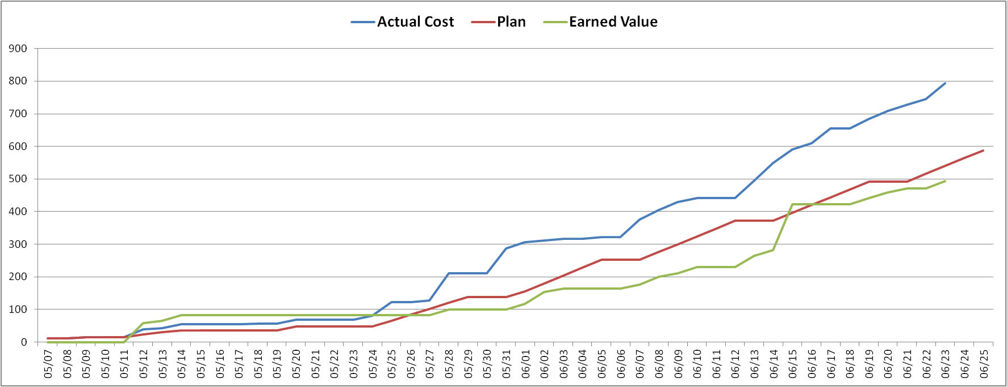
6.1 Time log & Earn Value
gap A
→ Long discussion and late decision about architecture design.
gap B
→ Under time estimation about workload.
gap C
→ Put the more resource to experiment & implementation.
gap C
gap A
gap B
W1
W2
W3
W4
W5
W6
W7
W8
Plan
Analysis (architecture driver)
Design( system context, perspective view )
implementation
Module test
System test
Documentation
KOREA
CMU

Slide 37
6.2 Role & Responsibility
Role | Responsibility |  | Assign
Project Manager | Risk & Issue Management , Schedule Management |  | JONGHYUN HAN
Architect | Requirement Analysis , Architecture Design |  | YOUK KWON
Requirement Manager | Requirement Management |  | JANG YOUNG KEUN
Test Manager | Test Strategy , Test Plan , Test Management |  | DONGOG MIN
Time Log Manager | Time log management , Earned value management |  | JUNG BO HYUN HYUN JIN WOOK
Development | IoTMS | User Interface manager , Log manager , message manager | JONGHYUN HAN
 |  | Rule manager | JUNG BO HYUN
 |  | Node manager | DONGOG MIN
 |  | Communication manager | YOUK KWON
 |  | Event bus + JSON | HYUN JIN WOOK
 | Arduino |  | JANG YOUNG KEUN HYUN JIN WOOK

Slide 38
6.3 Lessons Learned
* Future need
1. Implement adding emerging protocols.(Bluetooth, Zigbee..etc)
2. Implement the encryption (AES, RSA…etc) JSON message between IoTMS and Node.
3. Implement watchdog for single point failure recovery of event bus.
* Lesson Learned
1. Stop discussion, do experiment. - A.J. Lattanze
→ Schedule was delayed for a long meeting about design decision.
Arduino memory constraint
→ RAM is 2K byte.
→ There are many dynamic memory allocation problems of Arduino library(serial ,WiFi, String , JSON).
→ Mitigate the lack of RAM using program memory(flash)
3. Decoupling is good.
Because we use the Event bus and JSON, it’s easy to integrate the modules.
4. Manner make the good team work.(with beer and sancks).

Slide 39
Demo Scenario
1. User Login
2. Add Home Node
1. Discover (SA Node home)
2. Register (Serial Number for Security)
3. Home Node Event Update
1. Door Open by alarm, Turn on the light
4. Add MailBox Node
5. MailBox Node Event Update
6. Away mode
1. Send Confirm Message (Twitter Phone)
2. Automatic Door Close, Light off
7. Secure mode : Human Break-in
1. Unknown coming in
2. Emergency message (Tweeter)
8. Malfunction
1. Sensor (Pin out )/ Actuator (Door)
9. Add Rule
1. Open door if mail arrives
2 Add invalid rule
10 . Show Log & Remove Node
Notes:
DBR2 : 센서 / 엑츄에이터 예제 서술
DBR3 : 센서 구조 예제 그림 그리기

Slide 40

Questions

